Slide 1
Hybrid Tugboat Feasibility Study
AUTO 566 Team 12 Final Presentation
Mark Livshin mlivshin@umich.edu
Sagar Singhal sagsngl@umich.edu
Stephen Olson olsonsao@umich.edu
Cheng-Chun Chien jimchien@umich.edu

Slide 2
Overview
Project Scope and Initiative
Project Approach
Configurations
Implemented Daily Load Profile
Corporate Collaboration
Conventional vs Hybrid Specific Fuel Consumption
Model Details
Results
Biggest Challenges
Future Work

Slide 3
QUICK RECAP

Slide 4
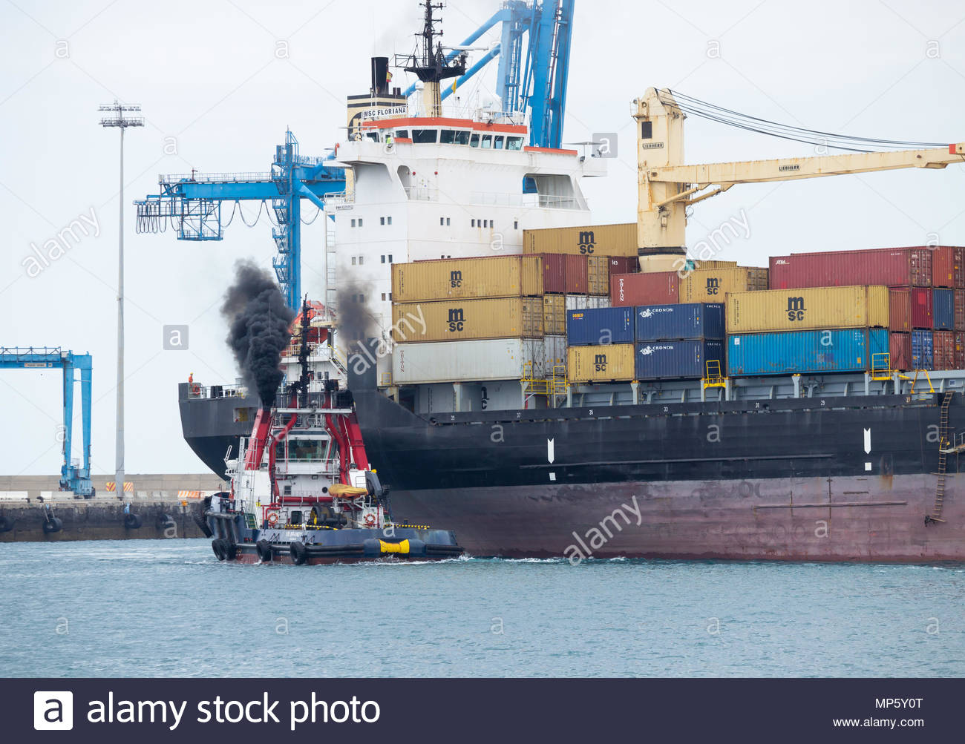
Project Scope and Initiative
Problem:
Maritime industry produces 5% of all greenhouse emissions
Tightening emissions regulations worldwide
Need:
A pathway towards the paris agreement of 0 emissions by 2050 must pursued
Hybrid TUGS provide an step forward in the path towards reduced emissions

Slide 5
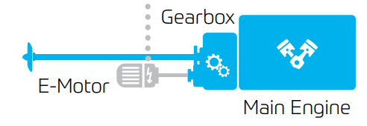
Project Approach
Approach
Evaluate benefits of parallel and series hybrid approaches and compare them to a baseline tugboat model
Benefit:
Industry pathway to hybridization of Maritime vessels
Solution can be added to existing power plants
Competition:
Model Solutions proposed by ABB and MAN (yet to be implemented)

Slide 6



Corporate Collaboration
Notes:
ABB - leader in electric propulssion
Motor Efficiency Curves
Caterpillar - leader engines and generator sets
Diesel Generator & Conventional Diesel Propulsion Engine/ Operational Specifications
SFC Data
Efficiency Information
ZF (Marine) - Propulsion Drivetrain expert
Transmission inertia
Propeller Resistance Data Profile
Prop RPM - Torque Curves
Mark

Slide 7
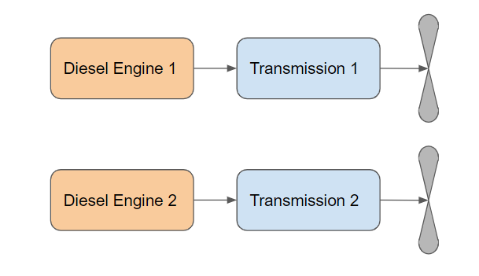
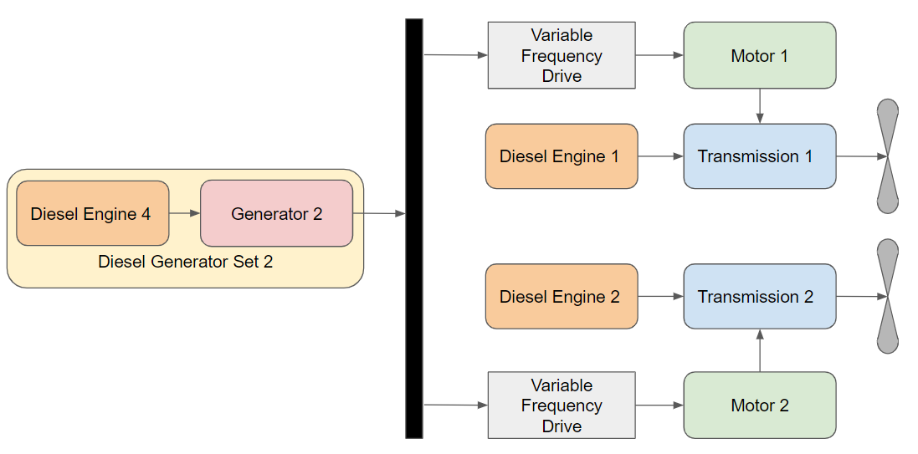
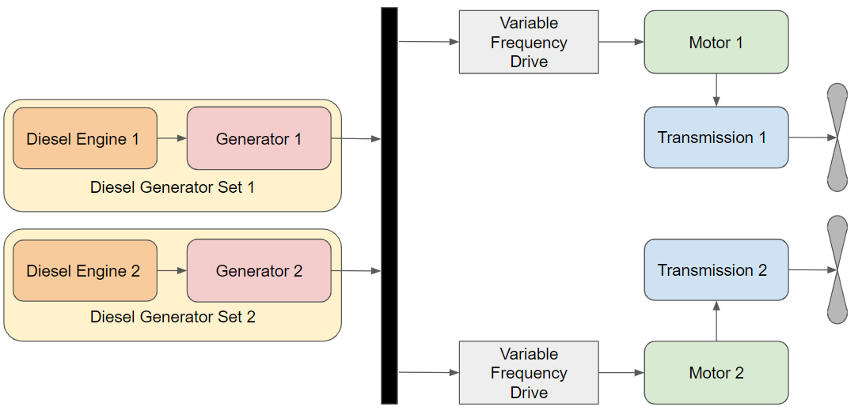
Configurations
Conventional Series Parallel
Notes:
Andy

Slide 8
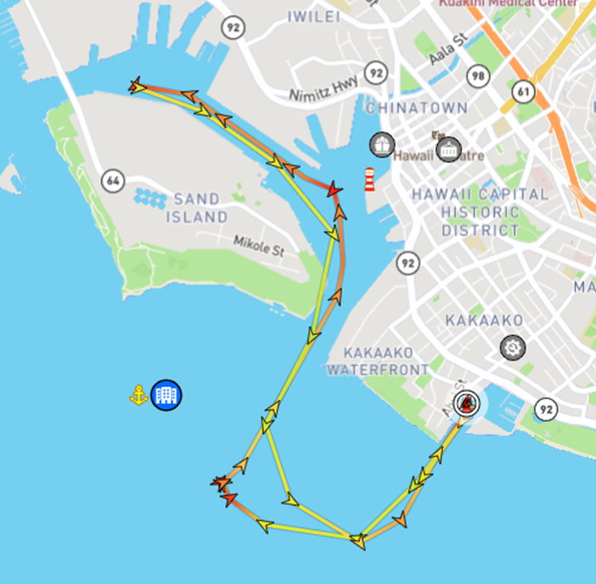
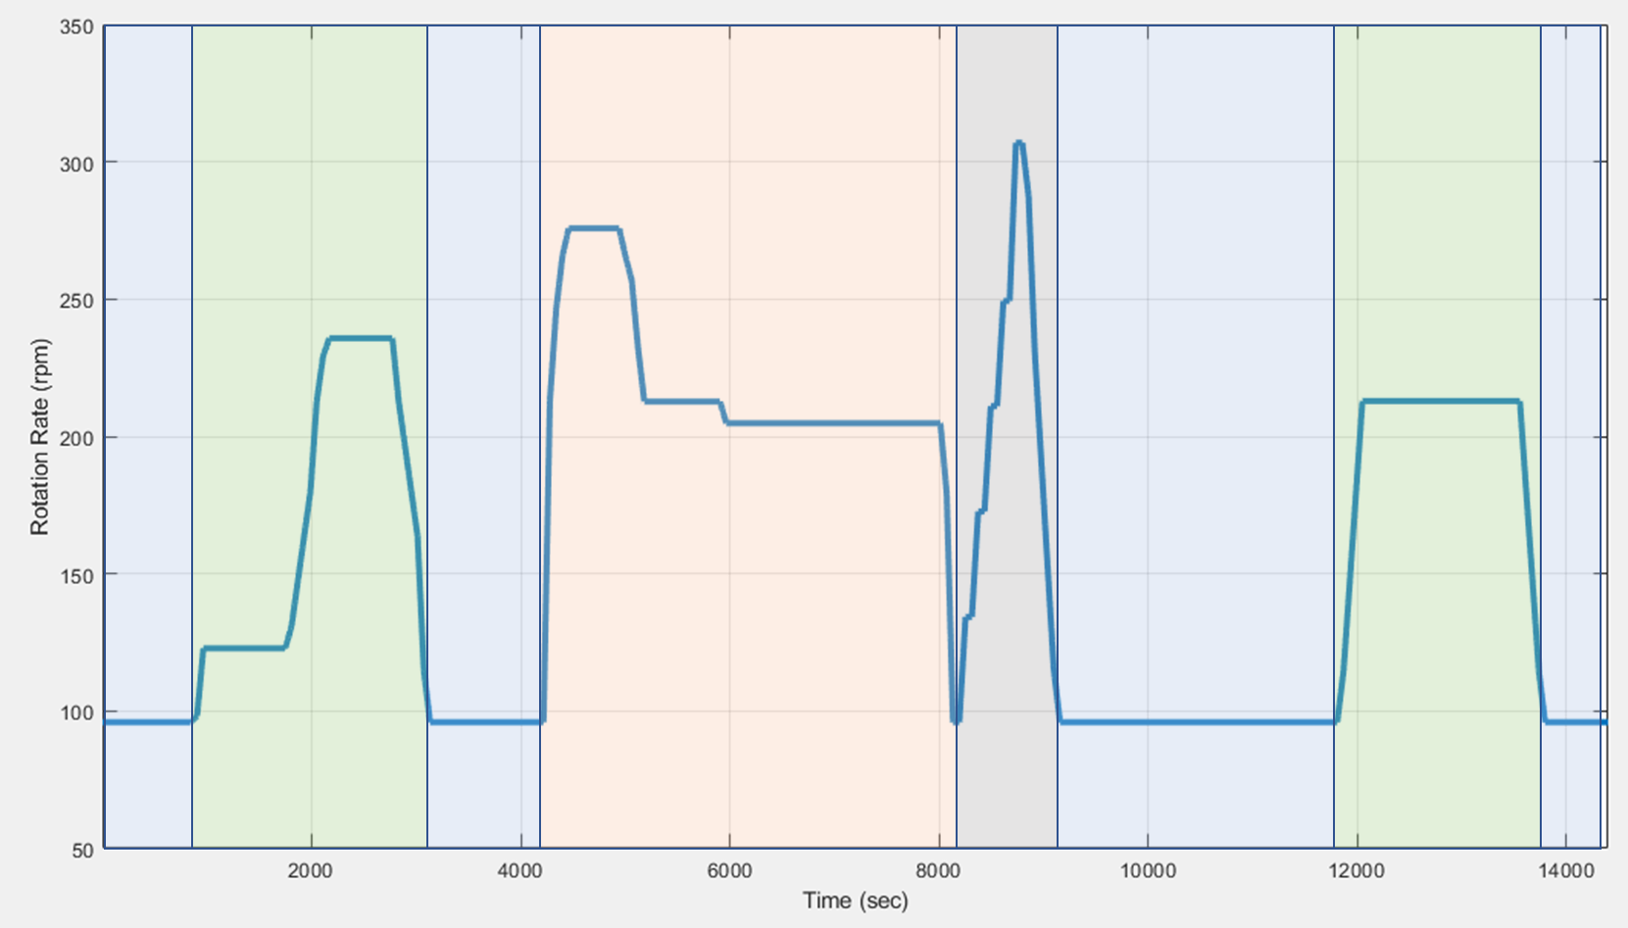
Implemented Daily Load Profile
MarineTraffic: daily operating route
Total operation time 4 hours
Four Operating Stages
Positioning / Idling: 37% (89 min)
Transiting : 28% (67 min)
Towing : 28% (67 min)
Bollard : 7% (17 min)
Positioning / Transit / Idling / Towing / Bollard / Idling / Transit / Positioning
Notes:
Jim

Slide 9
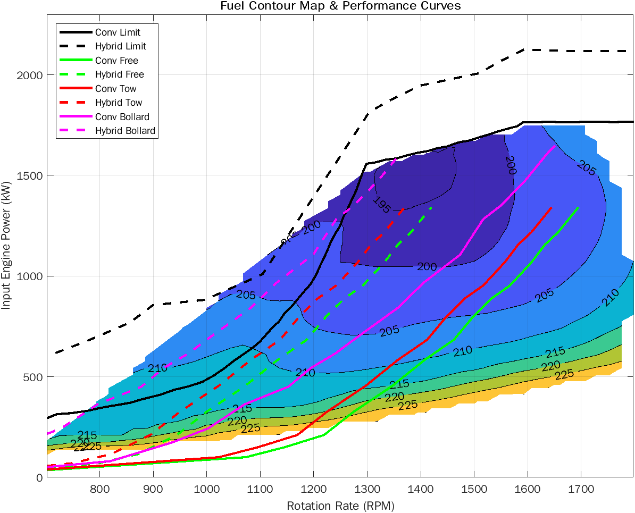
Conventional vs Hybrid Specific Fuel Consumption
Operational Cases:
Tow - Towing
Bollard - Thrust at zero speed
Free - Transit

Slide 10
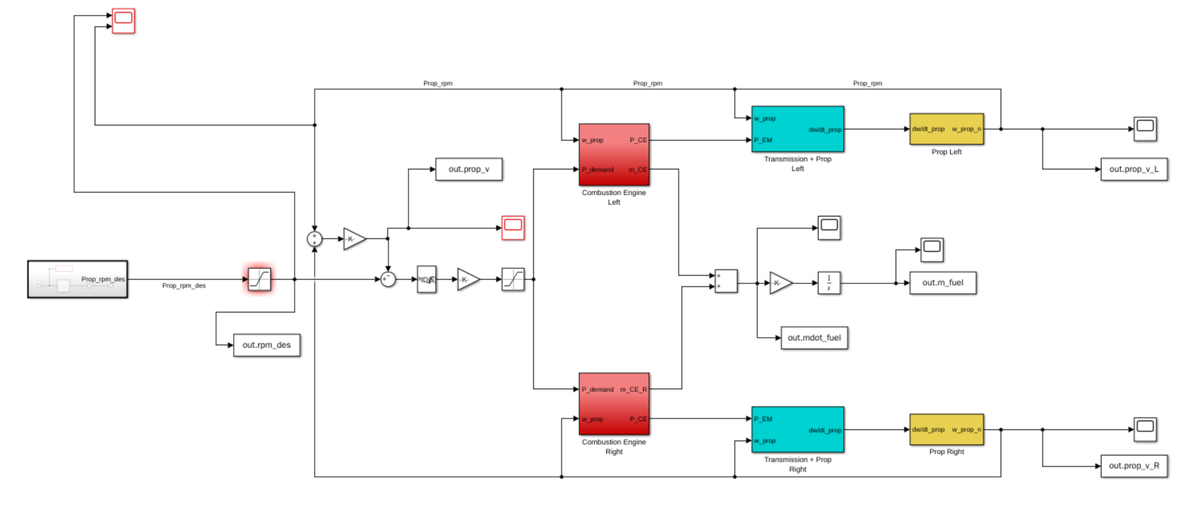
Baseline Model - Overview

Slide 11
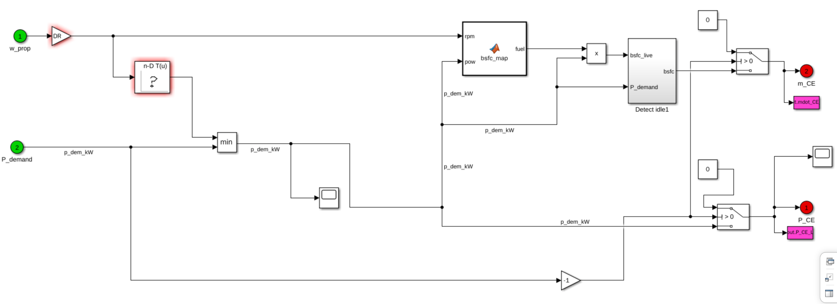
Baseline Model - Engine Controller

Slide 12
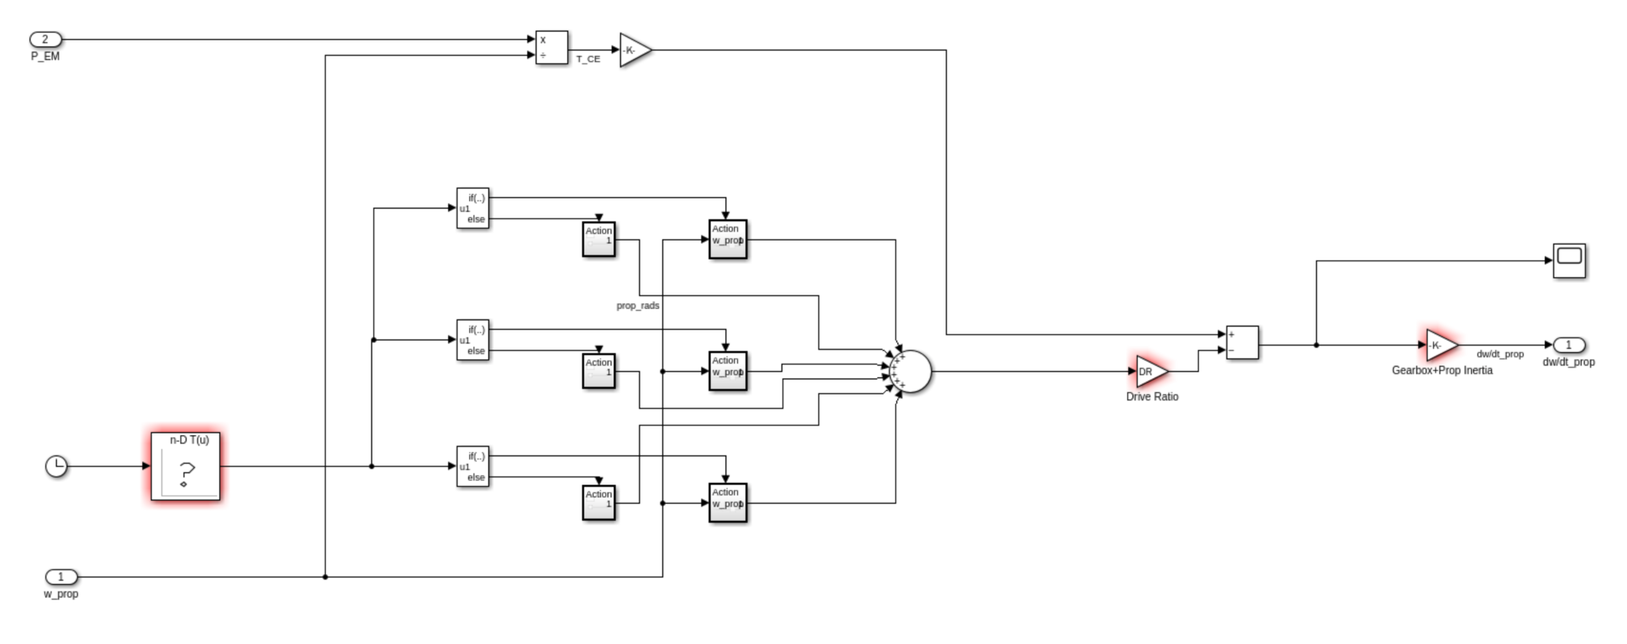
Propeller Controller

Slide 13
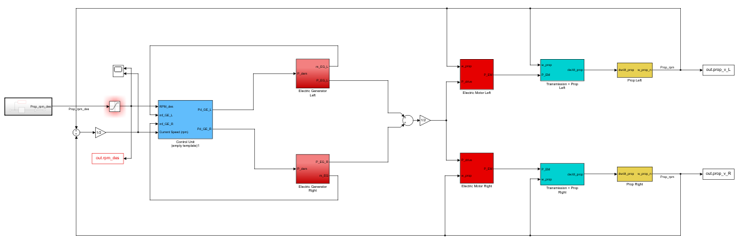
Series Model - Overview

Slide 14
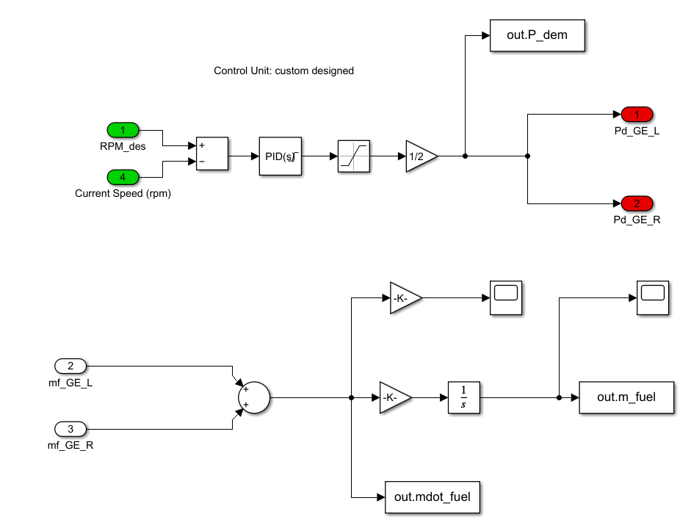
Series Model - Controller

Slide 15
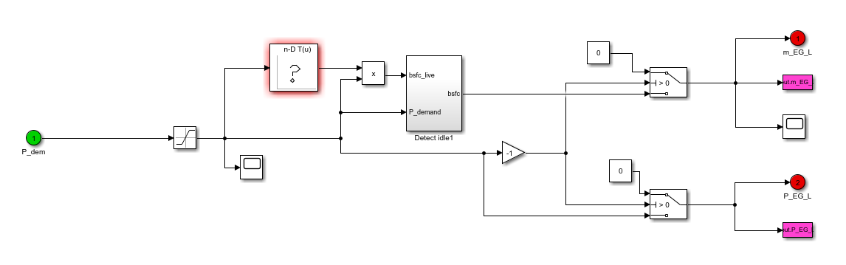
Series Model - Genset Controller

Slide 16
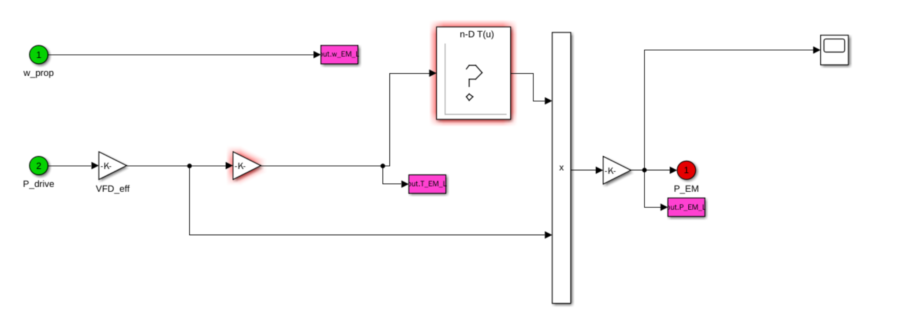
Series Motor Controller

Slide 17
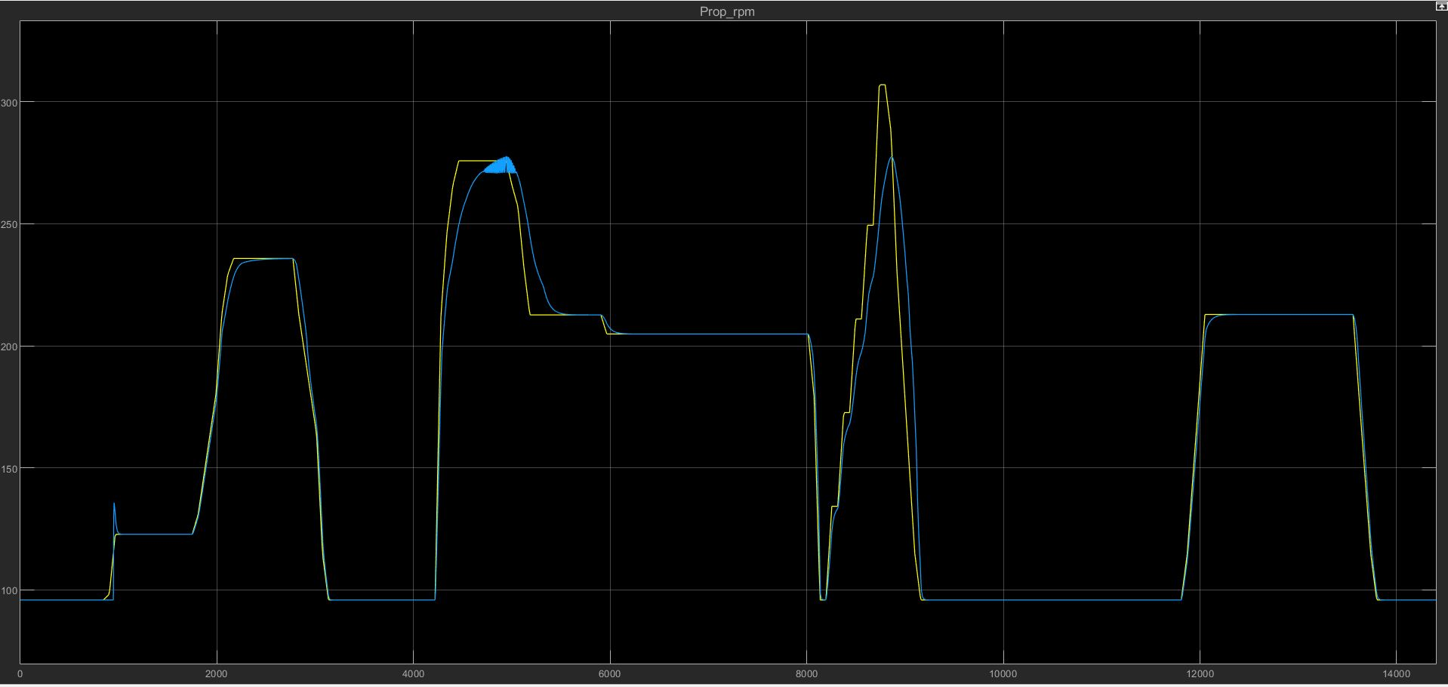
Legend:
_______ Target RPM
_______ Actual RPM

Slide 18
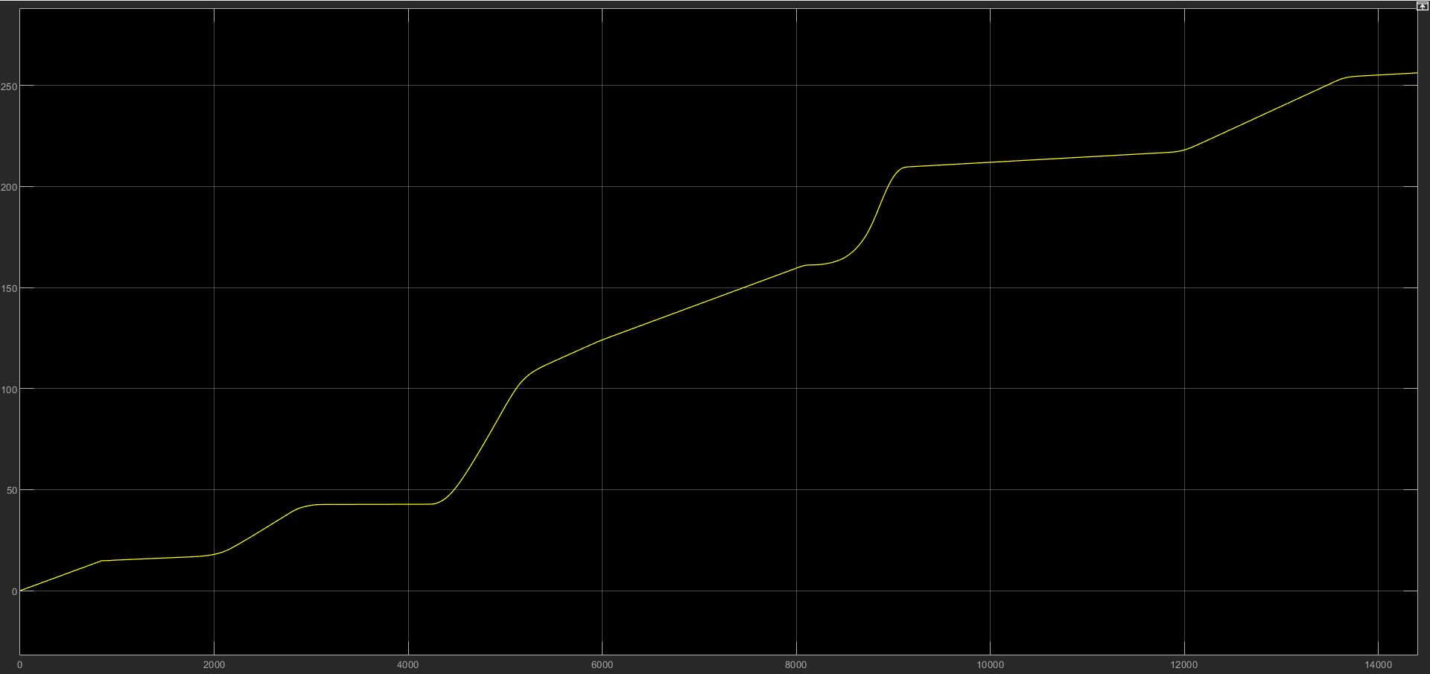
Fuel Consumption (kg) vs. Time (s)

Slide 19
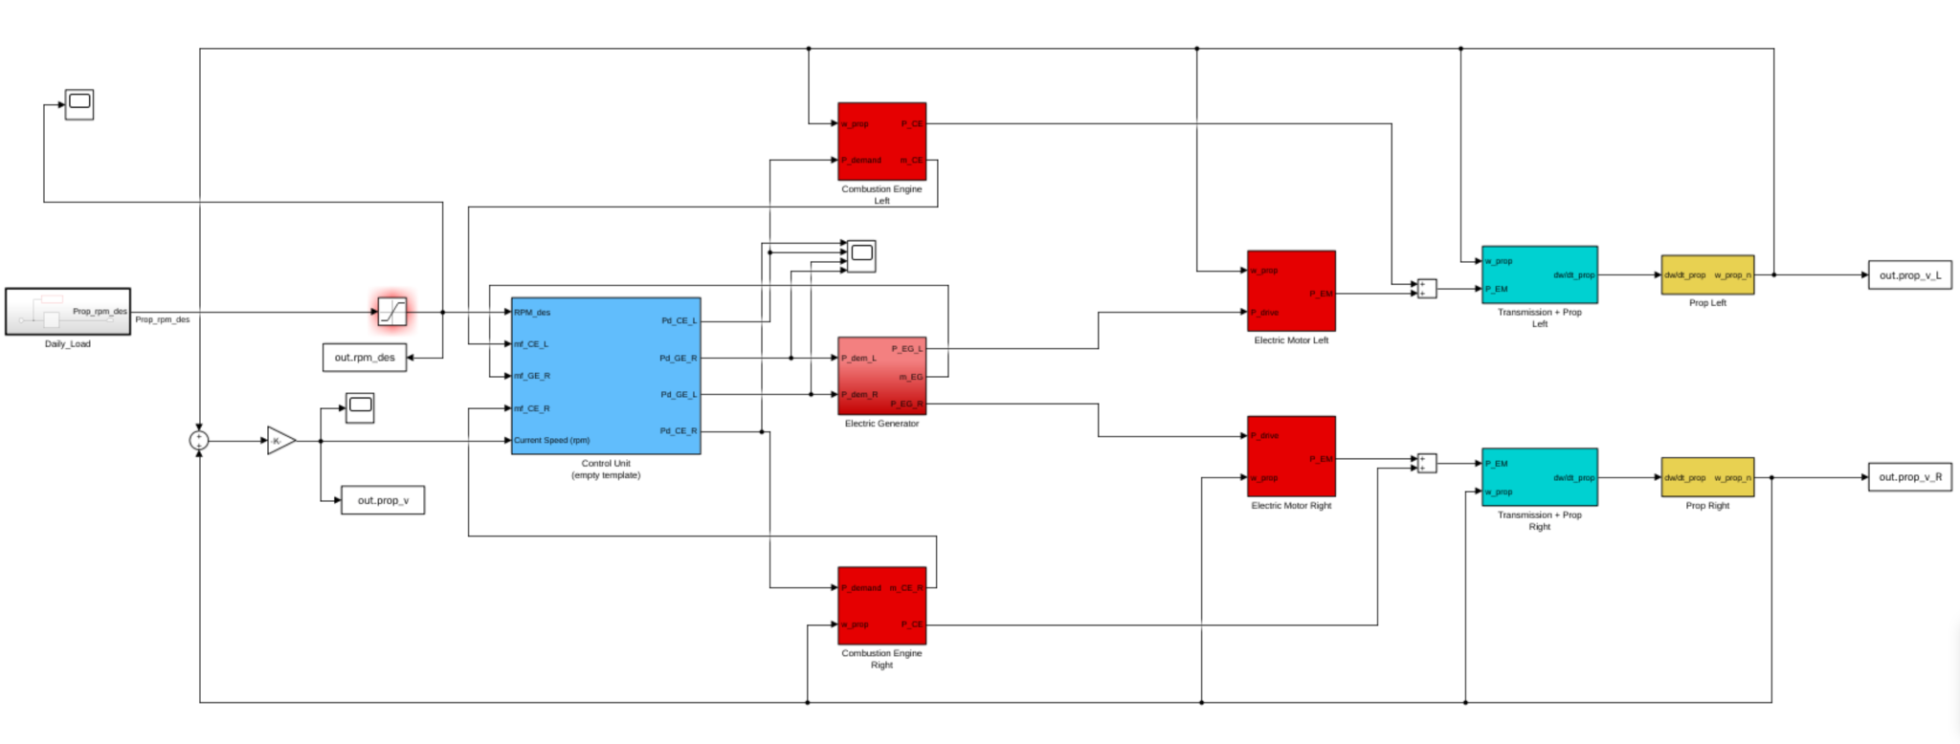
Hybrid Model - Overview

Slide 20
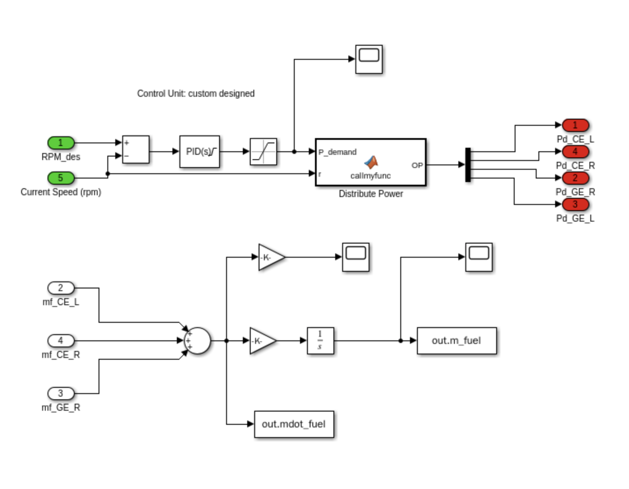
Hybrid Model - Controller

Slide 21
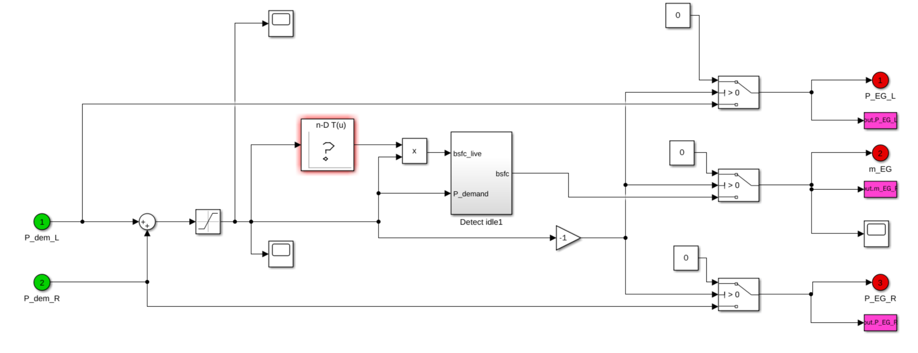
Hybrid Model - Genset Controller

Slide 22
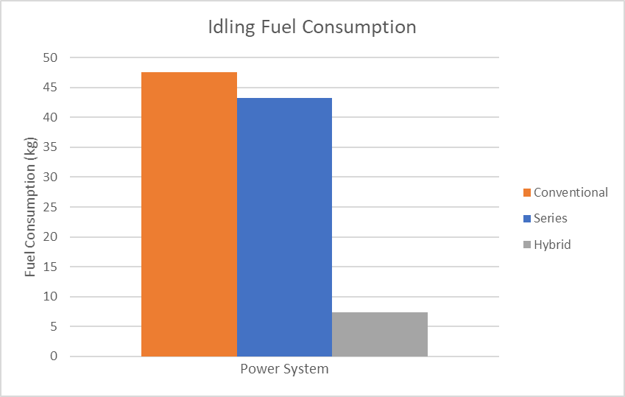
Preliminary Results
Notes:
We are still in the process of blending resistance profiles so that the models become more accurate

Slide 24

Biggest Challenges
Obtaining accurate model data
Hardware data
Operational data (theoretical vs. actual)
Controller Design
Varying modes and varied systems

Slide 25

Future Work
Model thrust vs. vessel velocity
Validate Assumptions against physical data
Real-time values vs Assumed Values
Consider Real-time Transient response effects

Slide 26
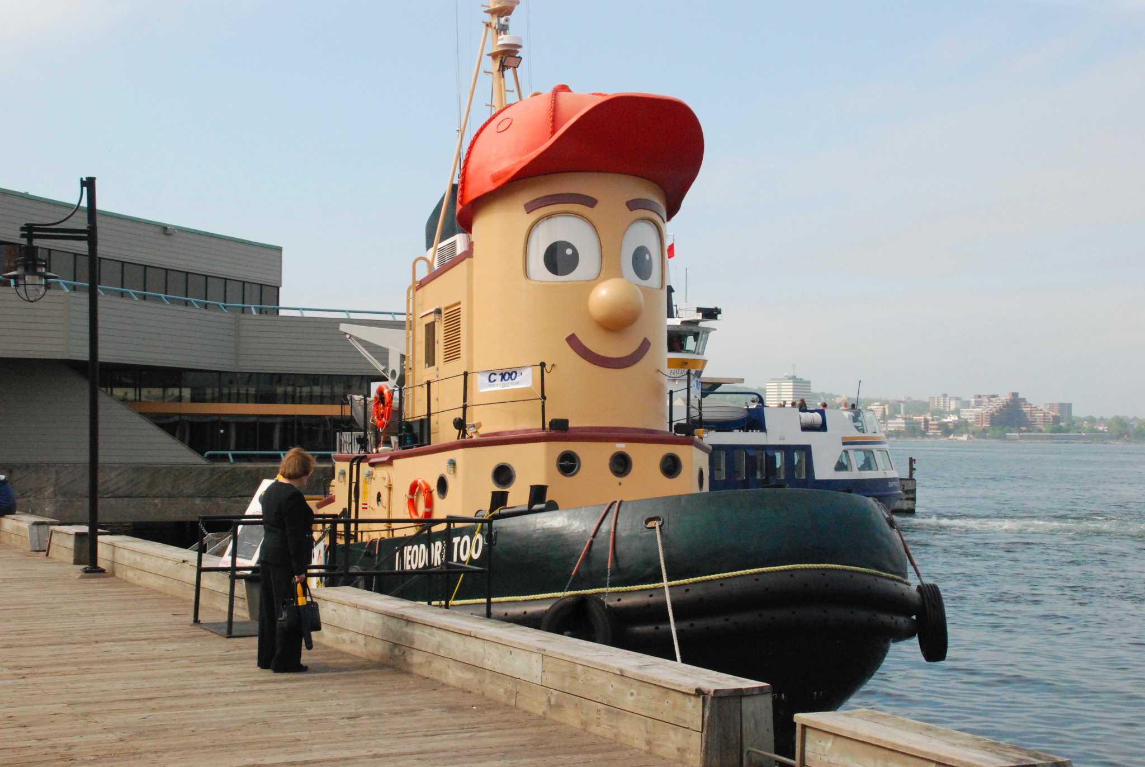
THANK YOU!

